Slide 1
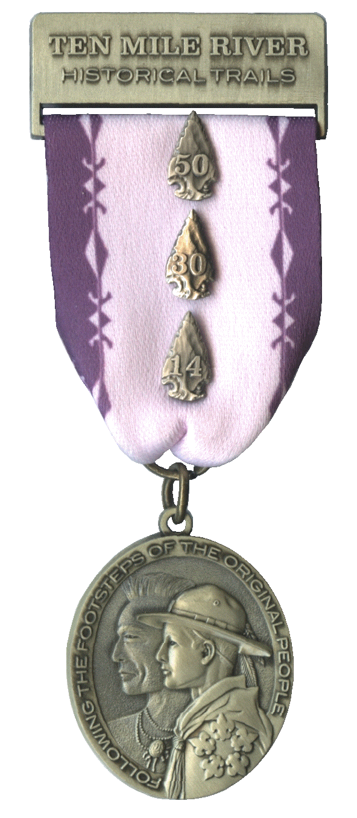
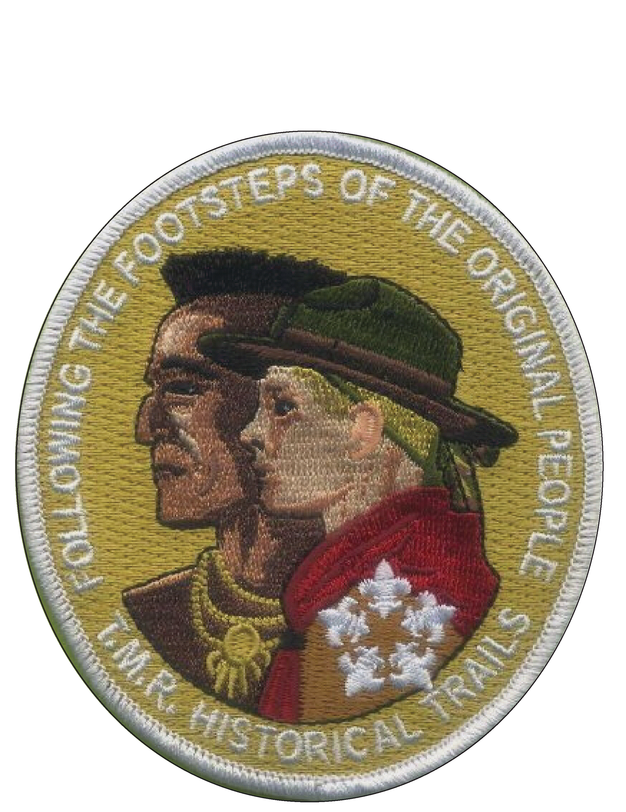
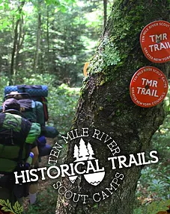
THE TEN MILE RIVER HISTORICAL TRAILS AWARD
THE TEN MILE RIVER SCOUT MUSEUM

Slide 2
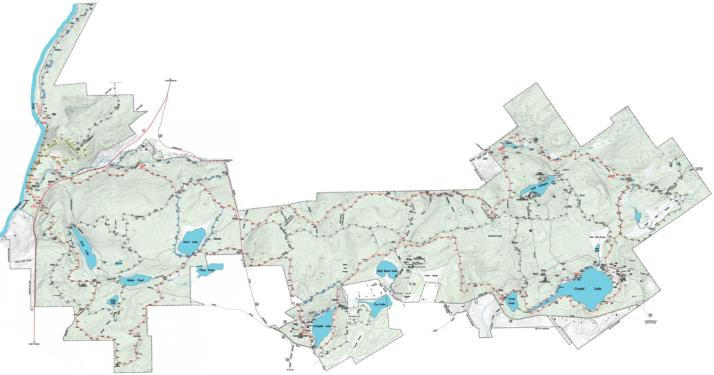
TMR has 12,000 acres & 60 miles of named trails!:
Black Ash Swamp Trail (Blue) – 0.8 mi.
Conklin Lookout Trail (Blue) – 2.0 mi.
Crystal Lake Trail (Blue) – 1.5 mi.
Davis Lake Hayden Loop Trail (Blue) – 2.8 mi.
Fox Lake Trail (Unmarked) – 2.2 mi.
Icy Pine Trail (Unmarked) – 3.2 mi.
Pisces Pond Trail (Unmarked) – 0.7 mi.
Ranachqua Lookout Trail (Unmarked) – 2.1 mi.
Rim Trail (Blue-Partial) – 5.7 mi.
Roosevelt Hill Trail (Unmarked) – 1.3 mi.
Settlement Trail (Unmarked) – 1.2 mi.
Spruce Creek Trail (Unmarked) – 0.4 mi.
Ten Mile River Trail (Red) – 32.3 mi.
Turnpike Lake Trail (Blue) – 0.3 mi.
Tusten Mountain Trail (Yellow) – 1.9 mi.

Slide 3
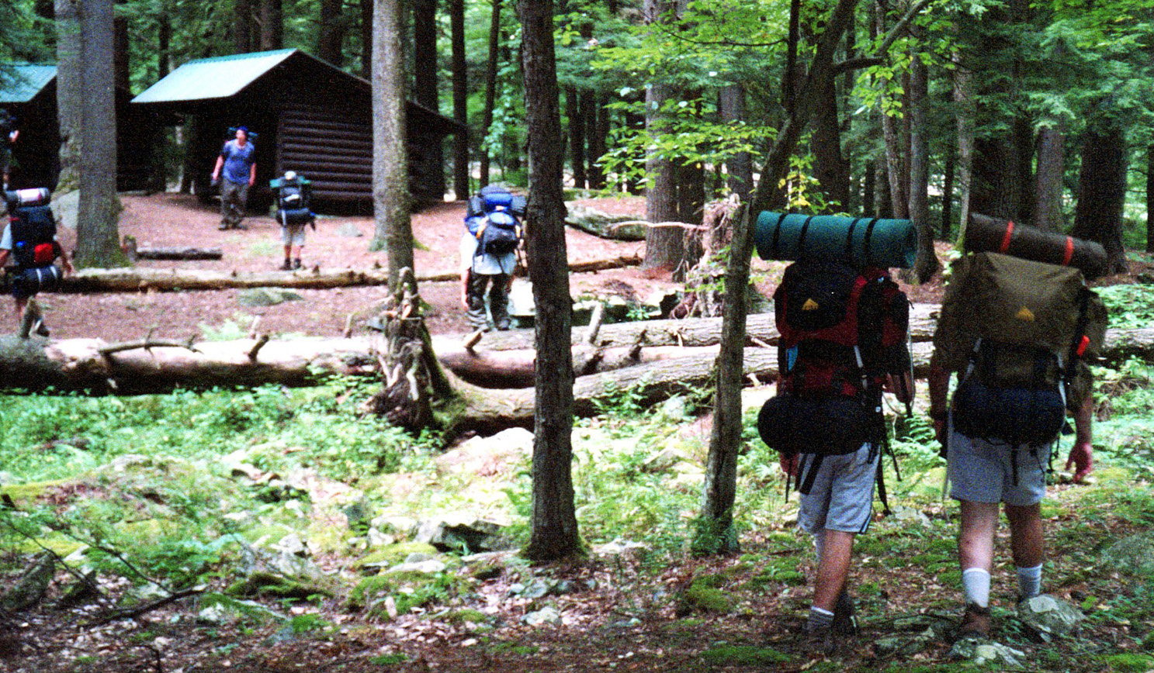
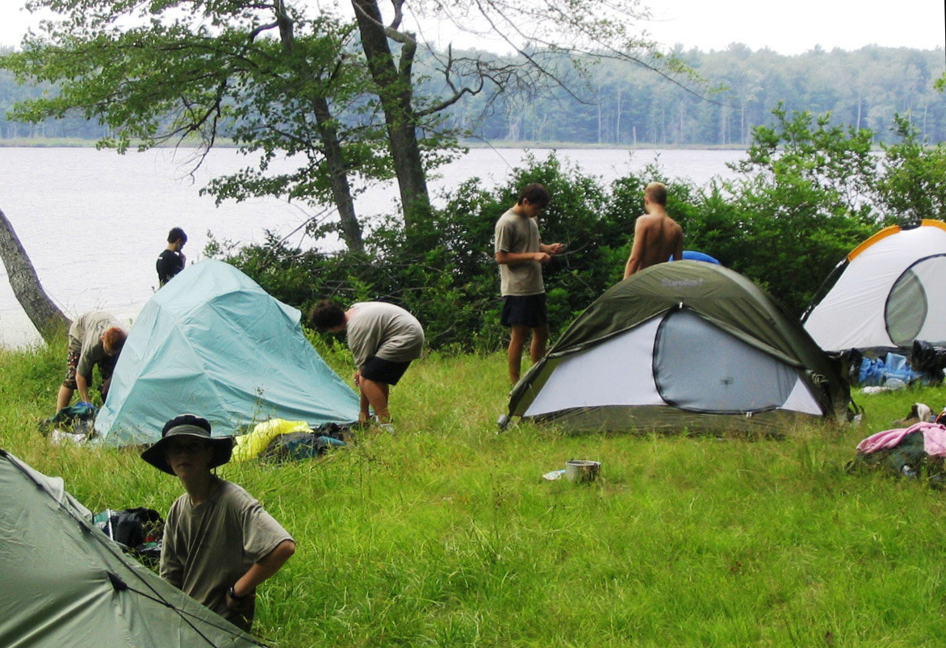
TMR has 17 Trailside Lean-to & Tent Sites!:
Lean-to Sites
Tent Sites
Arch Bridge
Beaver Pond
Conklin Farm
Frontier Village
Headquarters
Lakeside
Lenape
Old Spring
Ranger
Split Rock
Ten Mile River
Trout Pond
Conklin Farm
Lakeside
Ranger
River Sites
The Pines

Slide 4
The Ten Mile River Historical Trails is approved
by the National Council, Boy Scouts of America
and is managed by the
Ten Mile River Scout Museum.
All inquiries regarding the operation of the
The Ten Mile River Historical Trails
should be directed to the
Historical Trails Committee,
Ten Mile River Scout Museum.

Slide 5
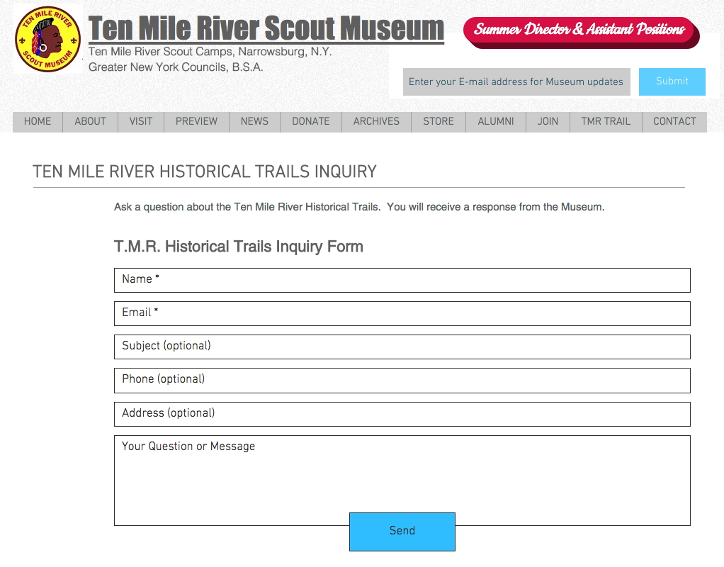
GET INFORMATION
Registration info kits, including maps, are available from the www.tmrmuseum.org and www.tenmileriver.org/hike websites. Paper copies can be requested through the www.tmrmuseum.org website, or picked up at the Ten Mile River Scout Museum or the G.N.Y.C. office.
Send inquiries to the Museum’s website: www.tmrmuseum.org
​

Slide 6
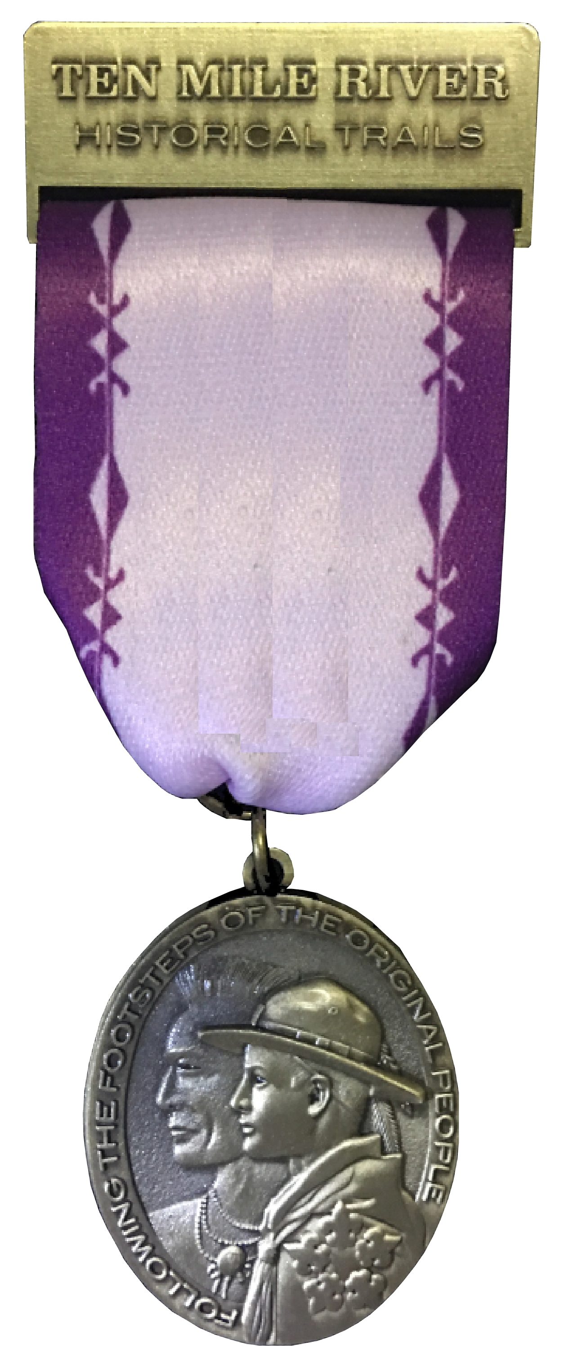
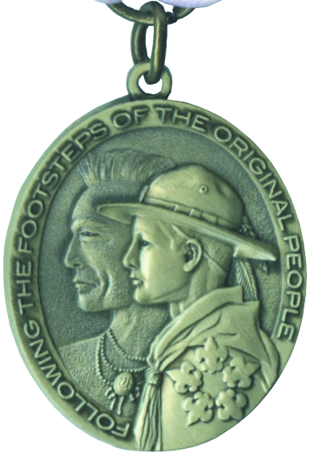
TRAIL AWARD REQUIREMENTS
​To Earn the Basic Trail Medal
Hike the TMR Trail system for at least ten miles.
Visit the TMR Scout Museum.
Take the Ten Mile River Historical Trails Quiz.
Write an essay of at least 100 words about what you learned about history from this hiking experience.

Slide 7
To Earn the 14-miler Device
Camp in the vicinity of the TMR Trail in an established campsite at TMR for at least two days and one night.
Hike 14 miles on the TMR Trail System during the two-day period, not exceeding ten miles per day.
Visit the TMR Scout Museum.
Take the Ten Mile River Historical Trails Quiz.
Write an essay of at least 100 words about what you learned about history from this hiking experience.

Slide 8
To Earn the 30-miler Device
Camp in the vicinity of the TMR Trail in an established campsite at TMR for at least three days and two nights.
Hike the complete TMR Trail or any other series of trails within the TMR Reservation totaling 30 miles, not exceeding ten miles per day.
Visit the TMR Scout Museum.
Take the Ten Mile River Historical Trails Quiz.
Write an essay of at least 100 words about what you learned about history from this hiking experience.

Slide 9
OR
Camp in the vicinity of the TMR Trail for at least one day and one night.
Hike 10 miles on the TMR Trail System.
Camp in the vicinity of the Delaware River for at least two days and one night.
Canoe 20 miles on the Delaware River during the two-day period.
Visit the TMR Scout Museum.
Take the Ten Mile River Historical Trails Quiz.
Write an essay of at least 100 words about what you learned about history from this hiking experience.

Slide 10
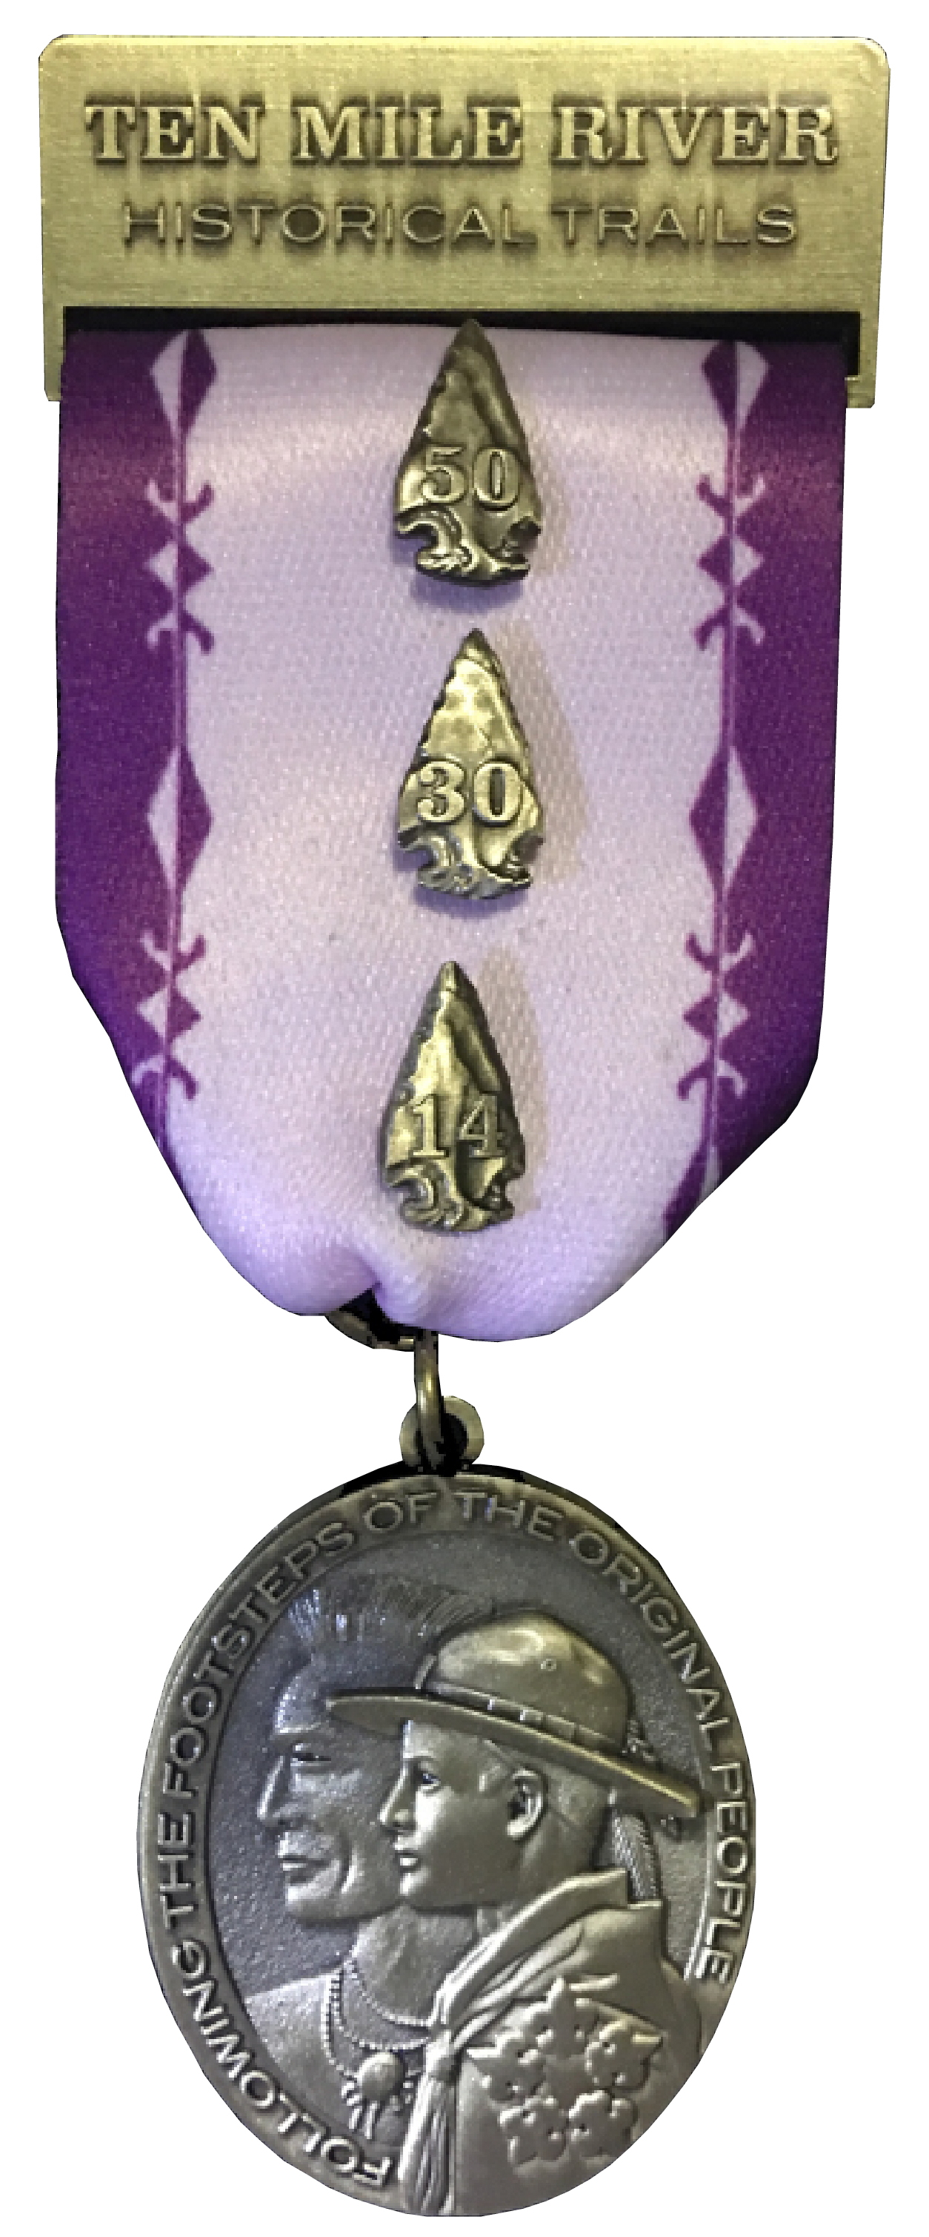
To earn the 50-miler Device
Hike the complete TMR Trail and a Delaware River canoe trip.
The total hike afoot/afloat must be 50 miles and must be taken within a continuous period of no more than seven days with foot trail hiking not to exceed ten miles per day.
Visit the TMR Scout Museum.
Take the Ten Mile River Historical Trails Quiz.
Write an essay of at least 100 words about what you learned about history from this hiking experience.

Slide 11
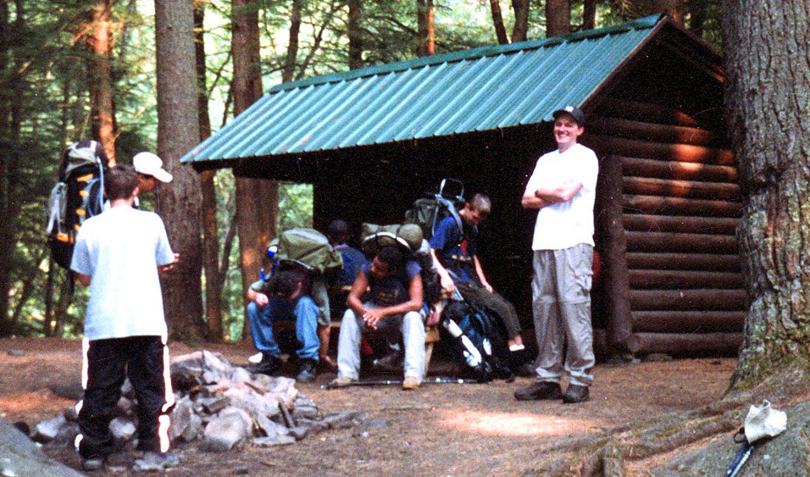
Notes
Units can complete the hiking/canoeing requirement and the Museum visit on different days and in any order. Both must be completed within eight months of each other. This means that Units can:
Visit the Museum during summer camp and complete the hike/canoe requirement in the Fall.
Complete the hike/canoe requirement during the Spring and visit the Museum during summer camp.
Earning a device also earns the trail medal and the option of purchasing the lesser devices. For example, if you earn the 50-miler pin, you can also purchase the 30-miler and 14-miler pins.

Slide 12
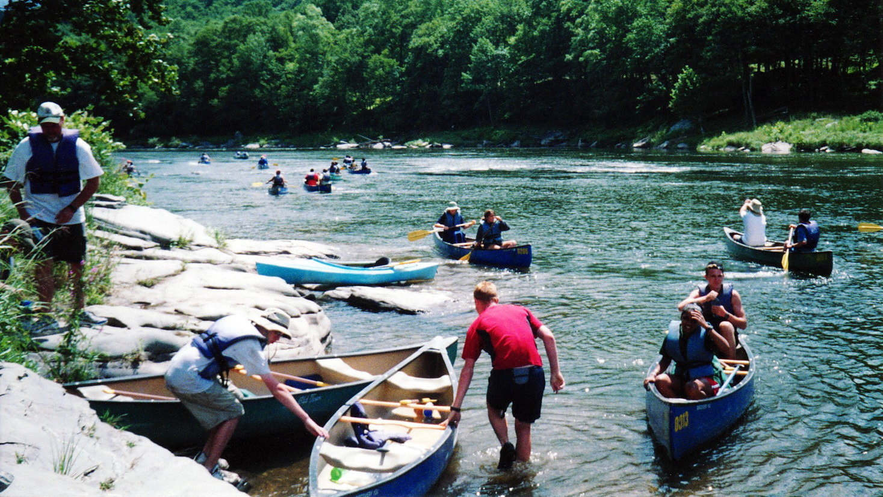
You must complete the entire hiking/canoeing requirement on one trip. You cannot, for example, complete the requirements for the 14-miler pin on one trip, and then hike an additional 16 miles on a subsequent trip to earn the 30-miler pin. You must complete the hiking requirement for the 30-miler pin on one trip.
No backtracking. You can’t hike 5 miles out and 5 miles back to complete the 10-mile hike requirement.

Slide 13
EARN THE TRAIL AWARD AT SUMMER CAMP
Get Ready!
Before camp, discuss the different trail award options with your Junior Leaders. Earning the medal requires a minimum 10-mile day hike, usually with a stop at the Museum at Headquarters Camp.
You can earn the medal plus a 14-miler pin by hiking a minimum of 14 miles over two days and camp overnight along the trail at a recognized TMR campsite. This might be best for your older Scouts with previous hiking and camping experience.
Earning the medal plus 30-miler or 50-miler pins will take up most or all of your week at TMR. We recommend that Units desiring to earn these pins during summer camp participate in the TMR Trek program, which provides all necessary food, patrol camping equipment and staff support.
​

Slide 14
While any trails at TMR can be used to satisfy the hiking requirement, the Museum recommends certain routes in the RECOMMENDED HIKE ROUTES BOOK. Each of these routes is designed to satisfy one of the trail award options (medal, 14-, 30-, 50-miler pins). Review the various hike routes and decide which one is best for you or design your own.

Slide 15
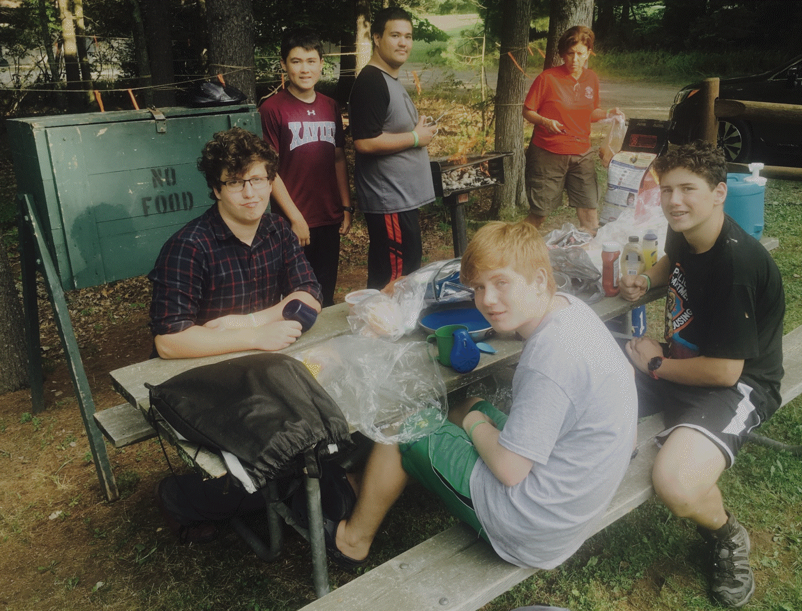
Register for the Trail
​
At Sunday TMR check-in, meet with your camp’s Program Director and schedule the trail award as part of your week’s program. If transportation is required, you should plan to provide your own. You can also request it from your Program Director, but TMR cannot guarantee transportation.
For a Day Hike (10-miler), your Unit should request a bag lunch or cookable “BBQ” meal. The “BBQ” meal can be cooked on charcoal stoves in the Museum’s picnic area.
For an Overnight Hike (14-miler), your Unit should coordinate acquisition of food with your camp’s Program Director.
Your Unit should bring your own packs, tents, patrol cook kits and camp stoves.

Slide 16
If you require an overnight campsite, contact the Reservation Program Director at Headquarters Camp and reserve one.
Contact the Ten Mile Scout Museum with a proposed hike route and schedule a date and time to visit:
845-252-2063 (T.M.R. internal phone system)
845-252-3775 (Public phone number)
Note: Not all hike routes might be viable due to trail conditions.
Complete the Trail Award Requirements
Complete the hiking/canoeing requirement.
Before, during or after your hike, visit the Museum at the scheduled date and time.
While at the Museum, your Scouts answer the quiz questions.
Your Scouts write the 100+ word essays.

Slide 17
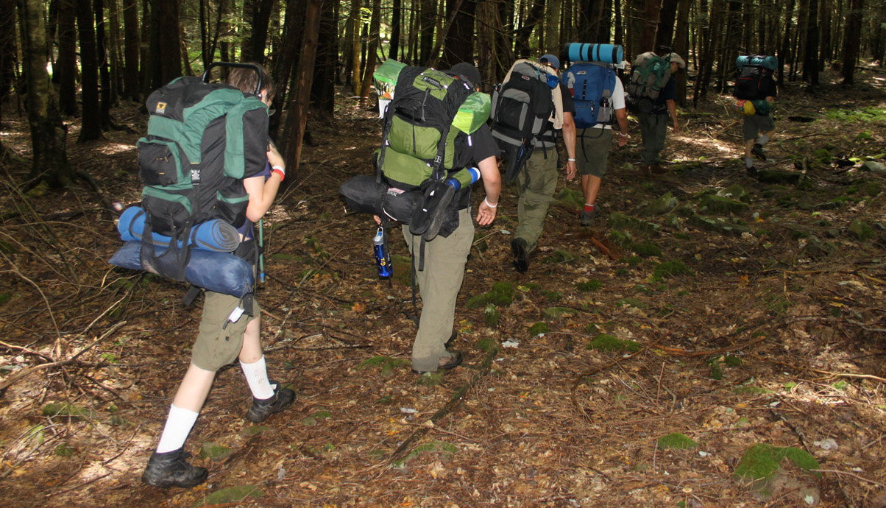
Purchase the Trail Awards
After your Unit completed all trail award requirements, call the Museum and arrange a date and time to submit all required paperwork (answers to quiz questions & essays) and purchase the awards.
At the Museum, submit the paperwork and an application to order trail awards. Pay for and receive your trail awards.

Slide 18
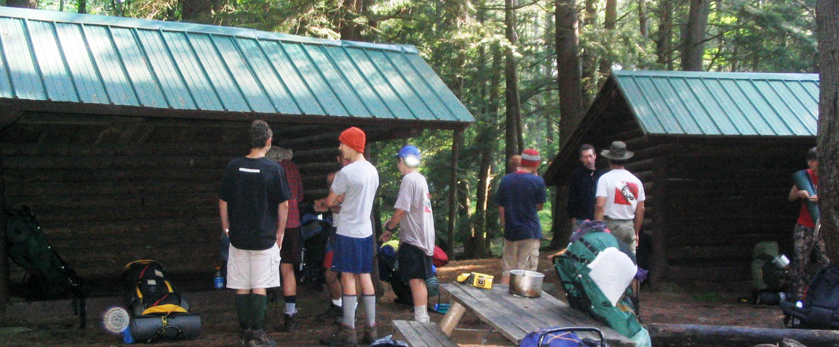
Note
The Unit can complete the hiking/canoeing requirement during the Winter or Spring and visit the Museum during summer camp.
In this case, after visiting the Museum, the Unit submits the required paperwork (answers to quiz questions and essays), pays for and receives the trail awards.

Slide 19
EARN THE TRAIL AWARD OUTSIDE OF SUMMER CAMP
Reserve Your Camp Facilities
Open Season: The Ten Mile River Historical Trails is open to hikers whenever TMR is open for Boy Scout camping. (Note: TMR is closed during the NYS Hunting Season, from mid-November to mid-December each year.)
Units can visit the www.tenmileriver.org website to determine when TMR is open for Boy Scout camping.
For a Day Hike (10-miler), the Unit informs GNYC Camping Services (212-651-3077, Hedwig.Debonet@scouting.org) that it wants to satisfy the Ten Mile River Historical Trails award requirements.

Slide 20
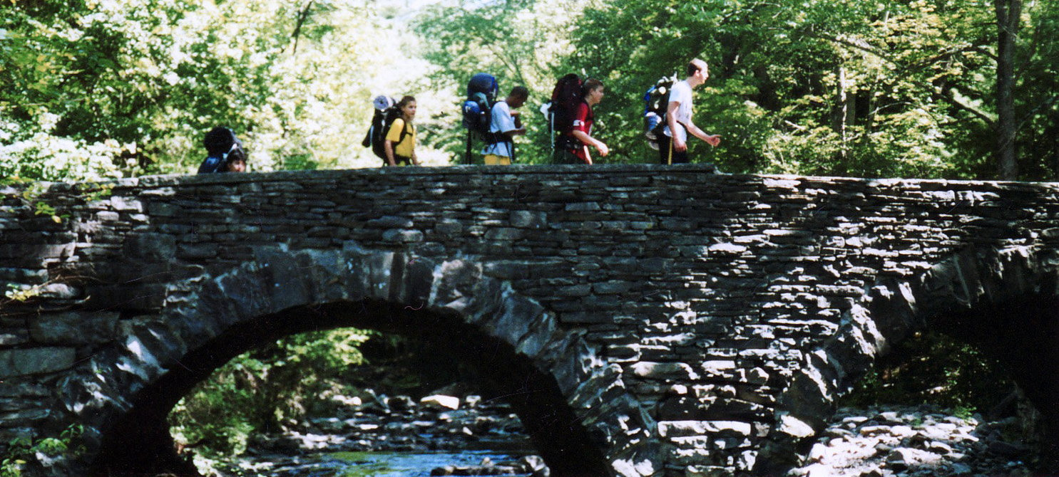
For a Multi-Day Hike (14-, 30-, 50-miler), the Unit reserves TMR lean-to and/or tent sites via the www.tenmileriver.org website or by contacting GNYC Camping Services (212-651-3077, Hedwig.Debonet@scouting.org).
Units can arrange a Delaware River canoe trip by calling 845-252-2011 (TMR Main Office).

Slide 21
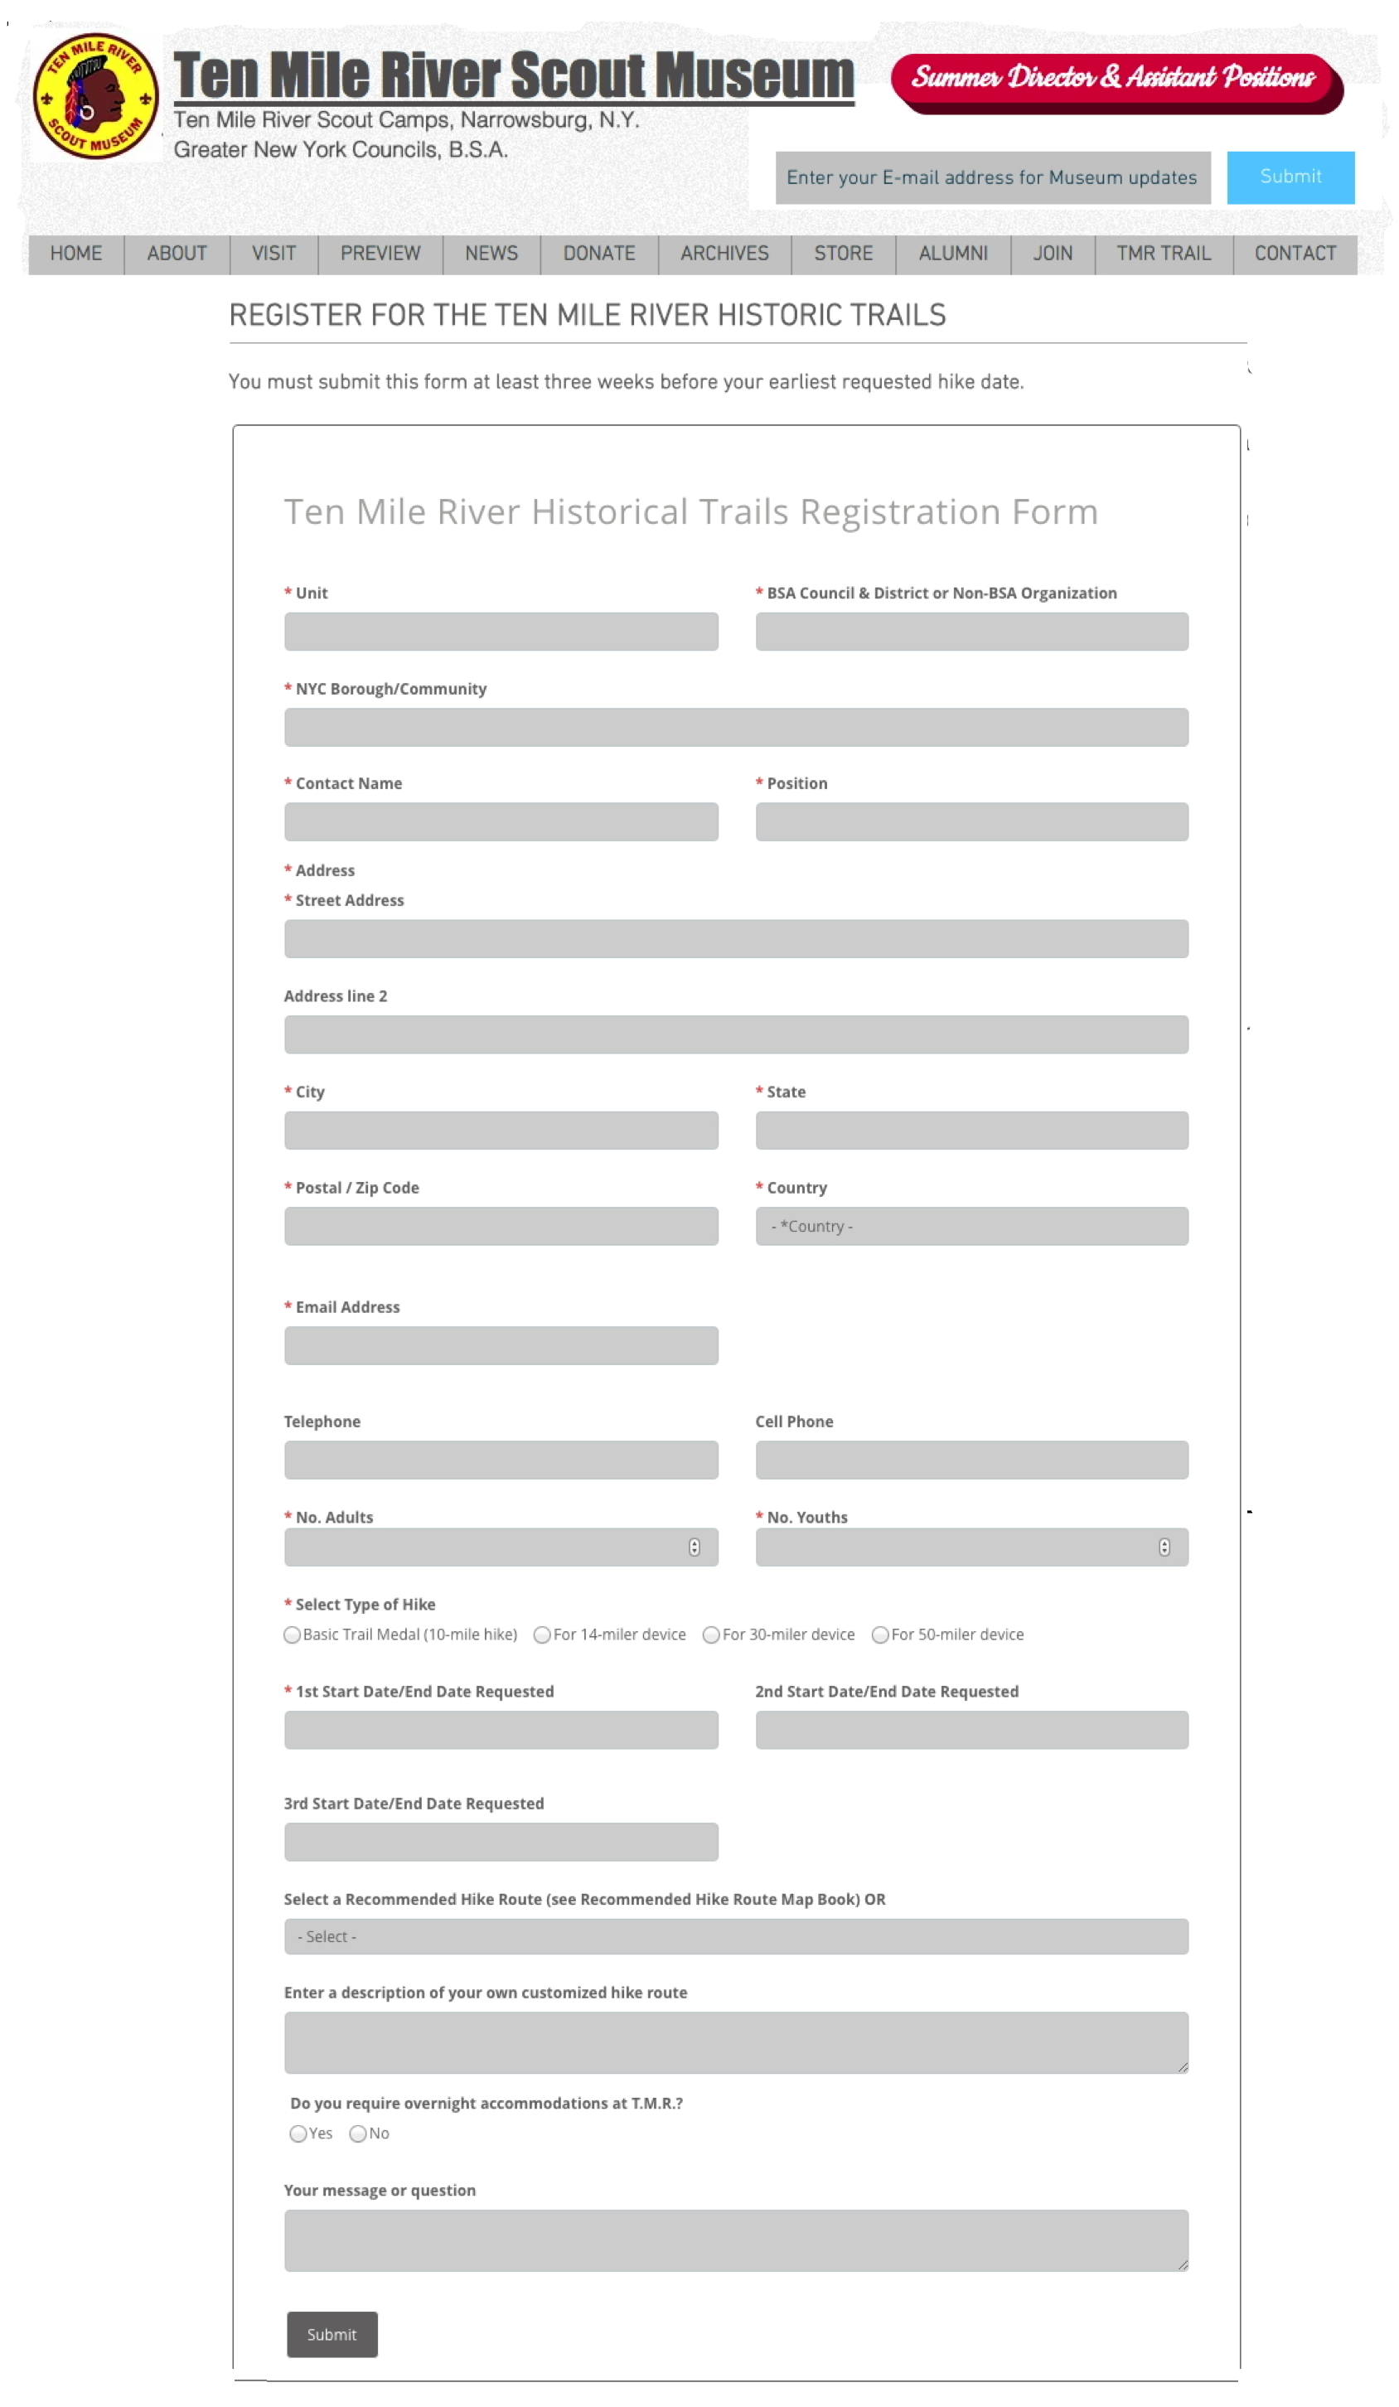
Register for the Trail Award
The Unit registers for the Ten Mile River Historical Trails through the Museum’s www.tenmileriver.org website, at least three weeks before their earliest hike date.
The Ten Mile River Historical Trails Committee replies to the Unit, confirming their hike date and route, and schedules a date and time to visit the Museum, if open that date.

Slide 22
At TMR
Upon arrival in camp, Unit checks-in with the TMR Ranger staff and informs them what route they will be hiking.
Day Units pay the $1 per person day-use fee.
The Unit completes the hiking/canoeing requirement.
Unit checks-out with the TMR Ranger staff so that they know that you left camp safely.
If the Museum is Open
Before, during, or after the hike, the Unit visits the Museum, answers the quiz questions and completes the essays.
Once all trail award requirements have been completed, the Unit submits the quiz answers, essays and application form to the Museum to order trail awards, pays for and receives the trail awards.

Slide 23
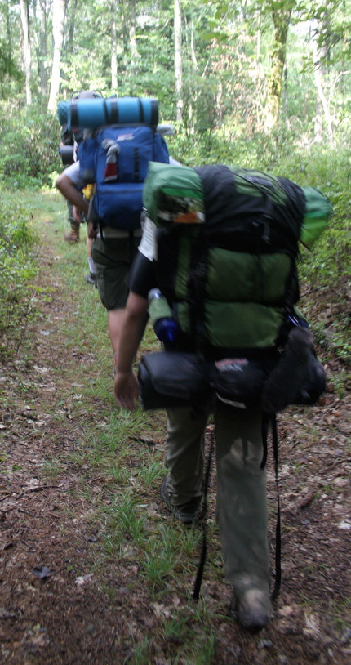
If the Museum is Closed
The Unit has eight months to visit the Museum, answer the quiz questions, write the essays and purchase the trail awards.
If the Unit Previously Visited the Museum
The Unit mails the quiz answers, essays, application to order trail awards, and payment for trail awards (check made out to “Greater New York Councils, BSA”) to:
Greater New York Councils, B.S.A.
350 5th Ave. Suite #7820
New York, NY 10018
Attn: Ten Mile River Historical Trails
The Museum mails the trail awards to the Unit.

Slide 24
Trail Awards Order Form

Slide 25
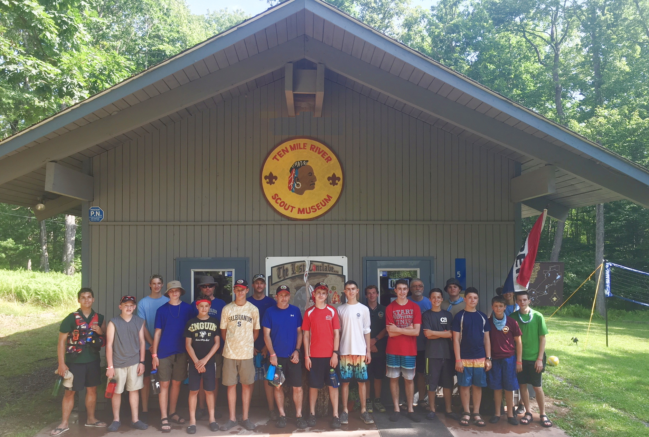
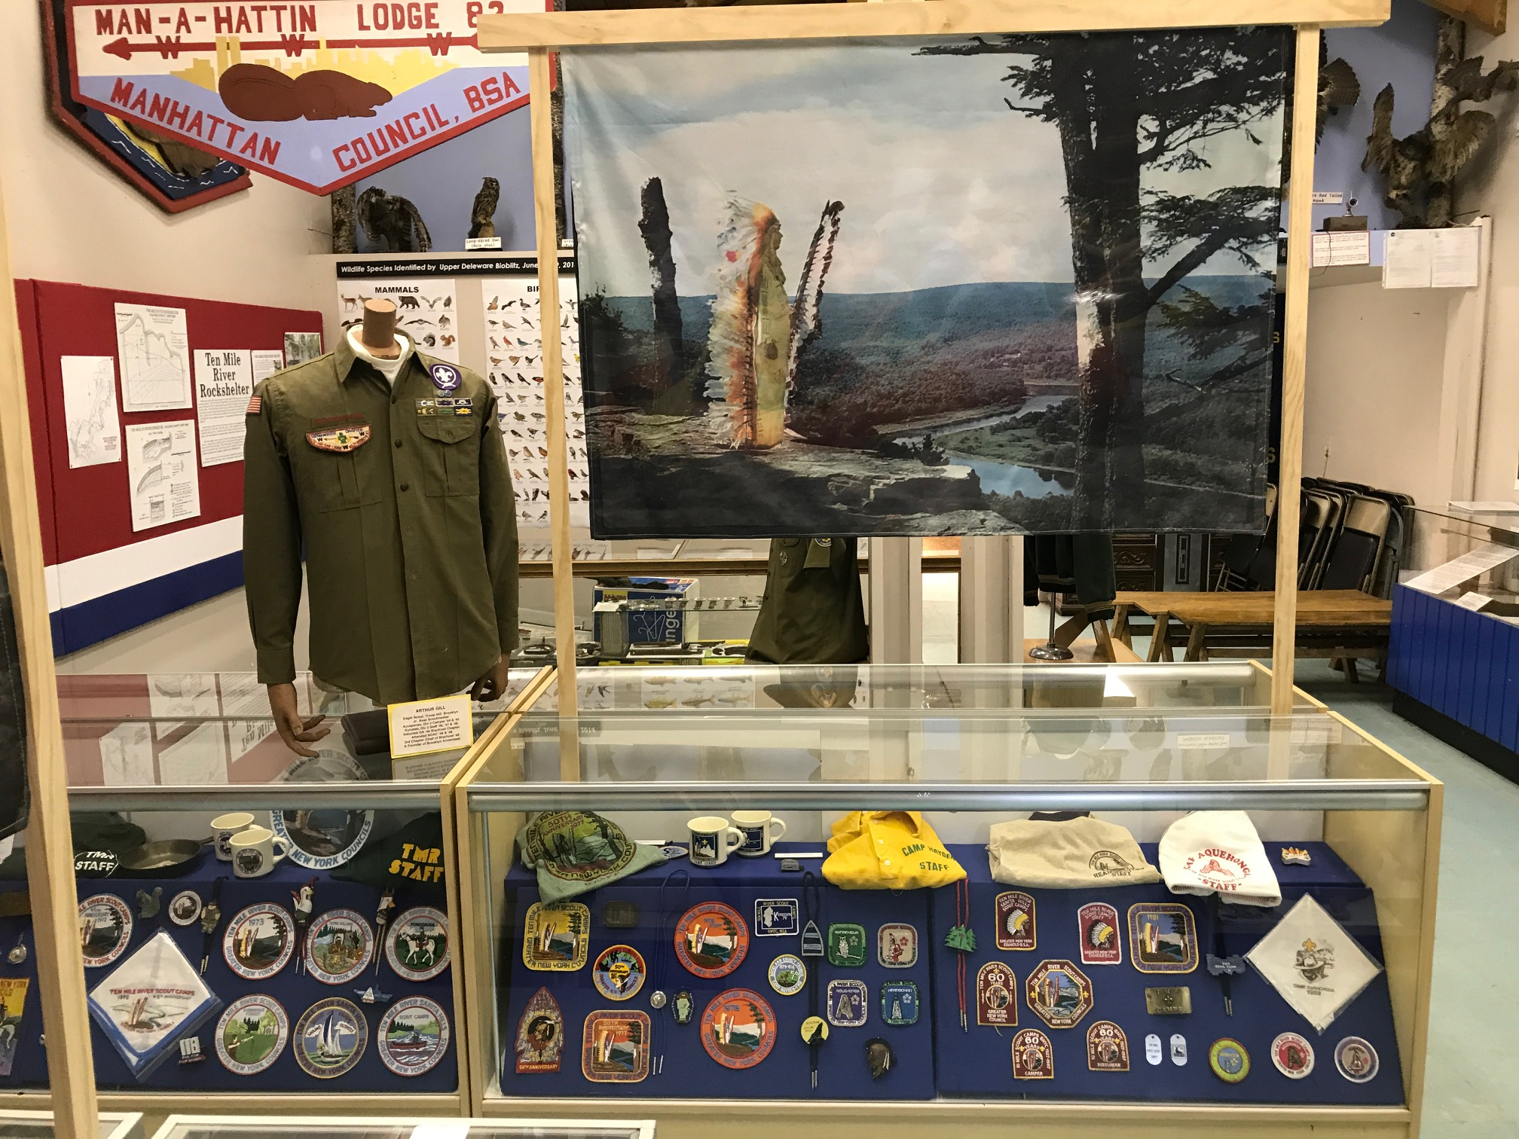
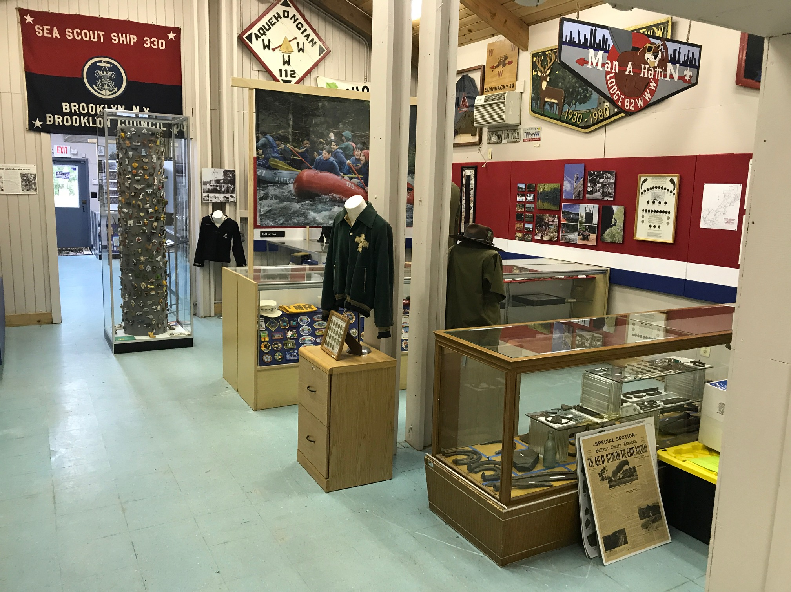
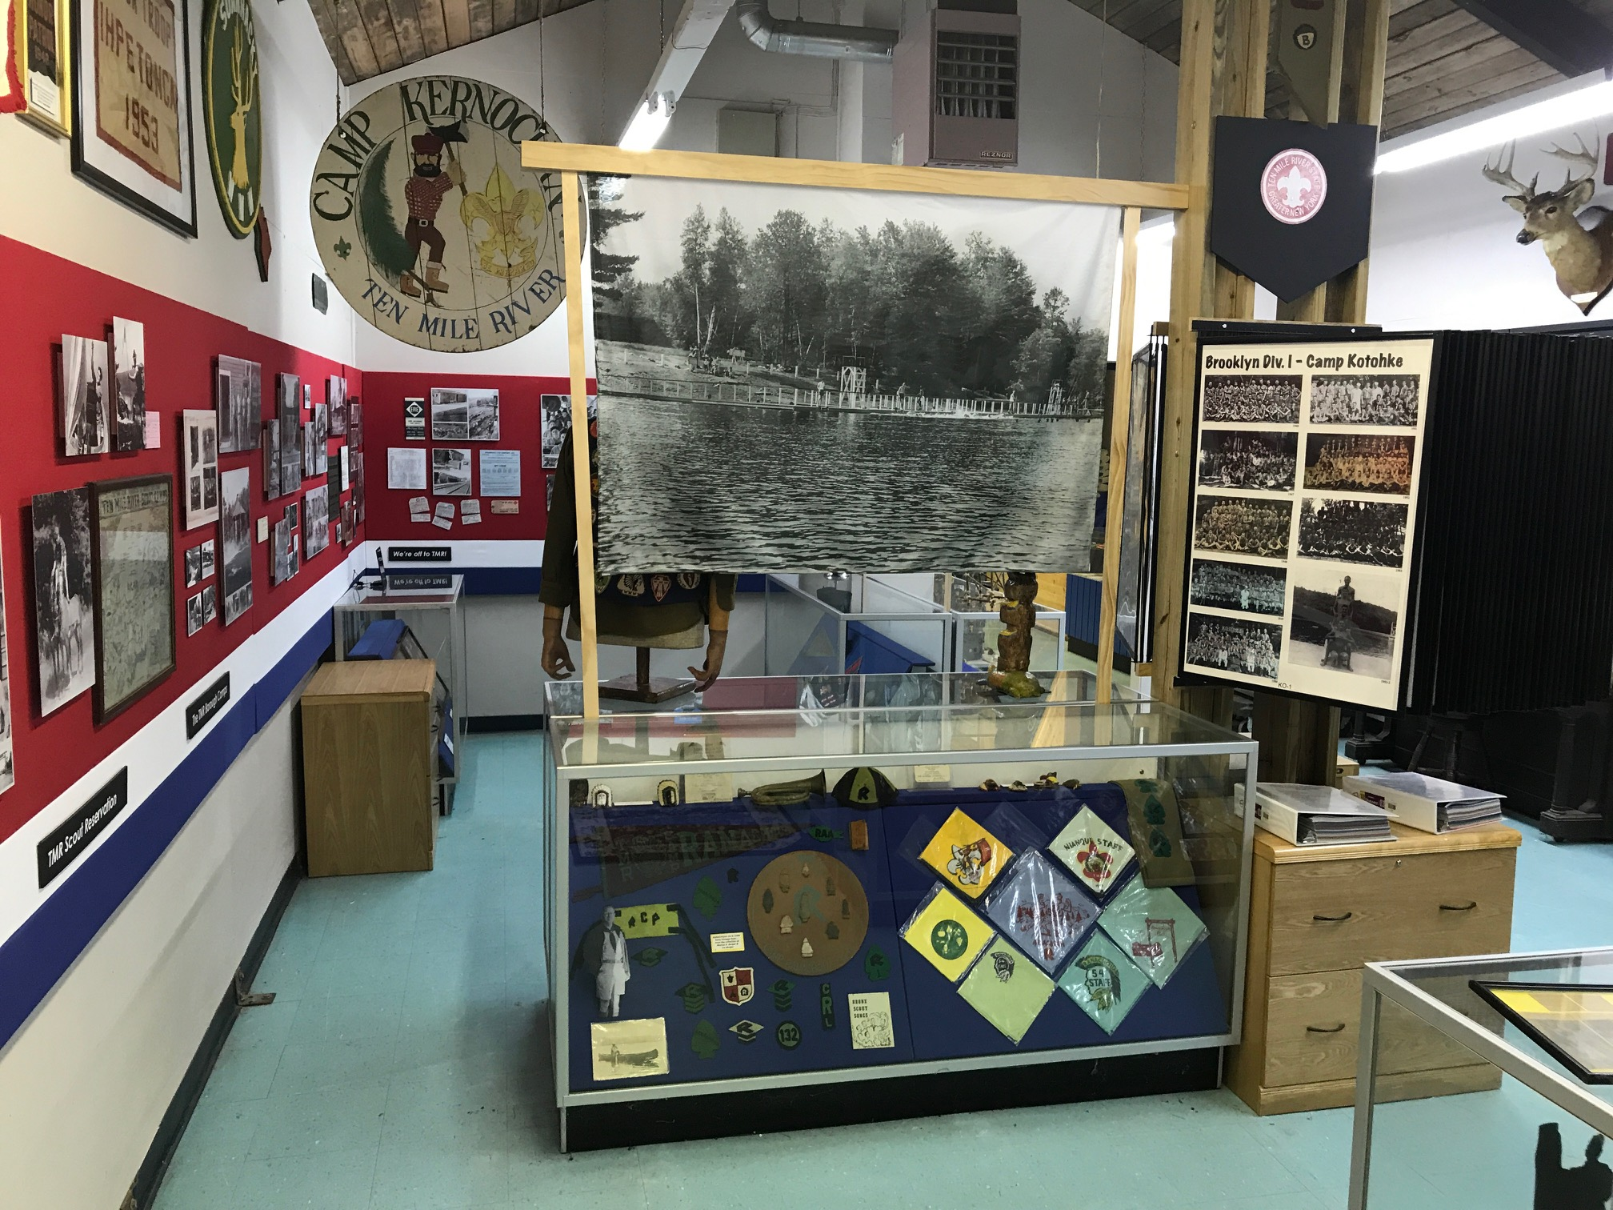
Ten Mile River Scout Museum
Exhibits on TMR and local history, including historic sites you visited while hiking around TMR.

Slide 26
The Ten Mile River Scout Museum Website
www.tmrmuseum.org/tmr-historic-trails-info

Slide 27
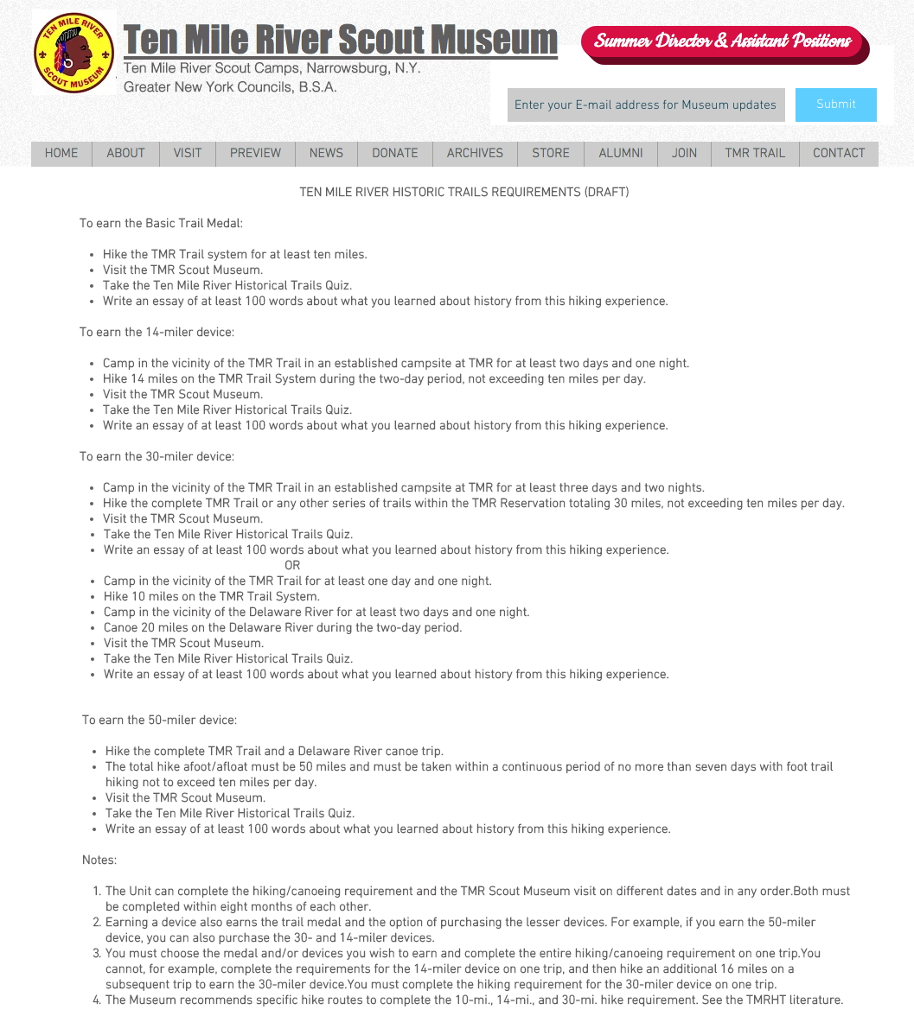
Trail Award Requirements

Slide 28
HOW TO EARN THE T.M.R. HISTORICAL TRAILS AWARD

Slide 29
How to Earn the Trails Award at TMR Summer Camp

Slide 30
How to Earn the Trails Award at TMR’S OFF-SEASON

Slide 31
Online Registration Form

Slide 32
Inquiry Form

Slide 33
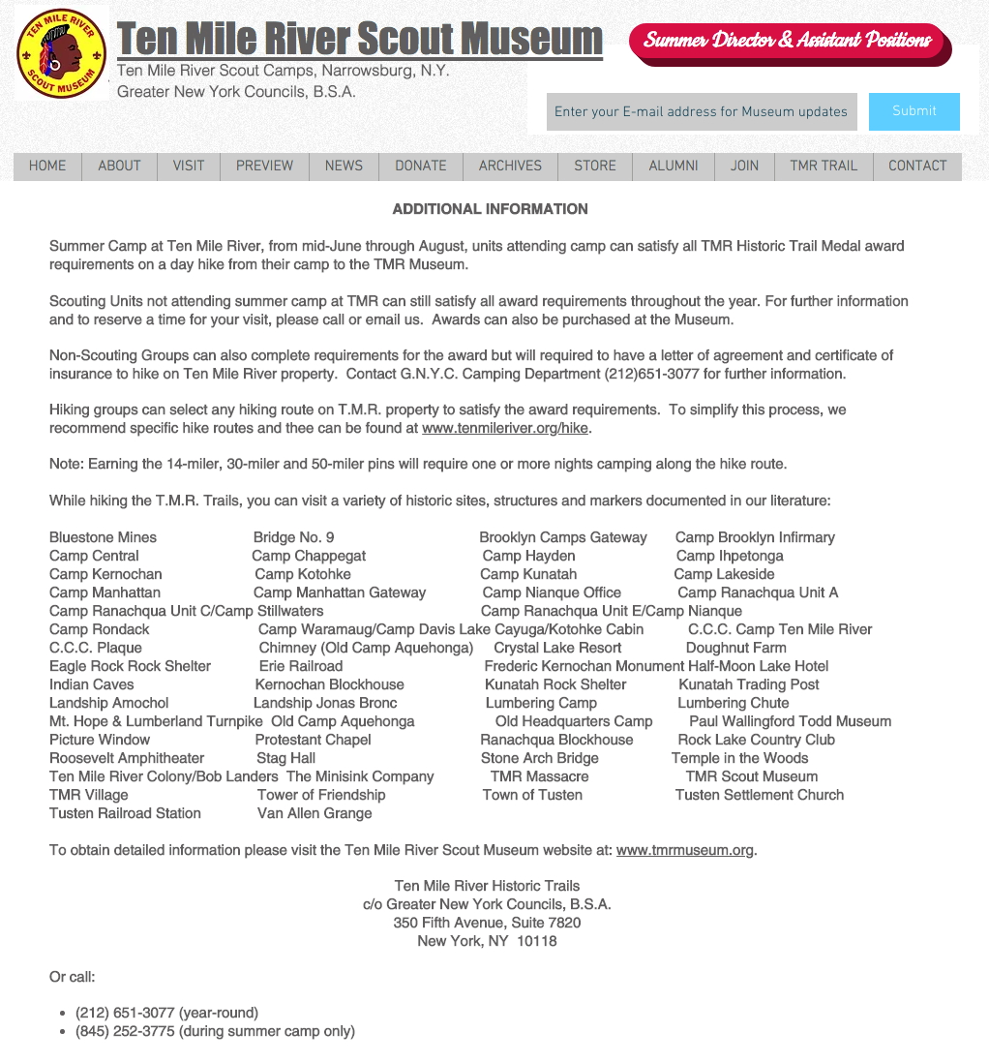
Additional Information

Slide 34
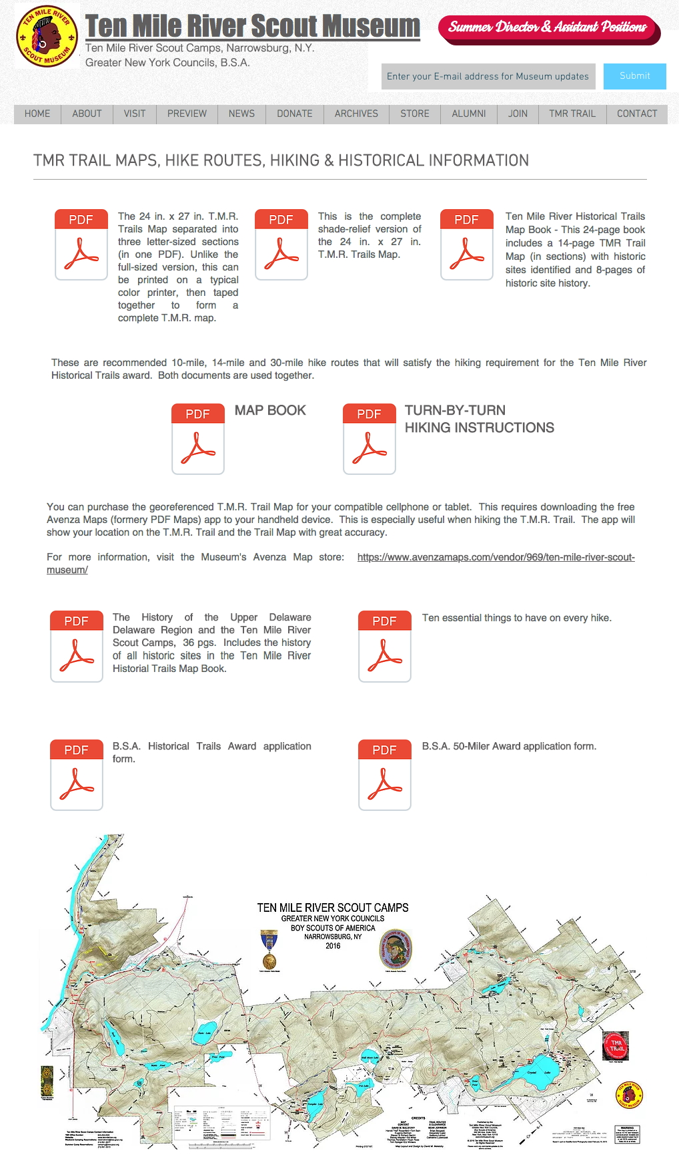
Trail Maps, Recommended Hike Routes, History & Hiking Info

Slide 35
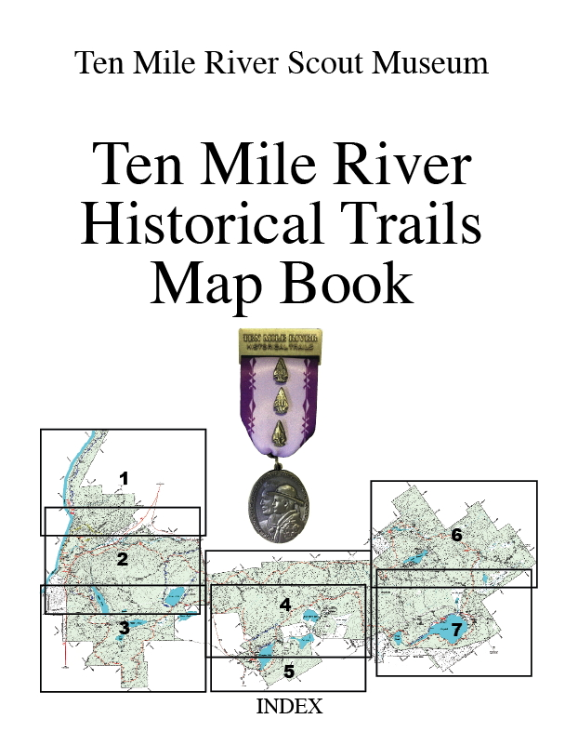
Additional Resource Materials
Ten Mile River Historical Trails Map Book
Detailed trail maps of the Ten Mile River Scout Camps with historic sites.
Short histories of all historic sites on TMR property.
Download from www.tmrmuseum.org/tmr-trail-map website.

Slide 36
Recommended Hike Routes Map Book
Turn-by-turn Hiking Instructions for the
Recommended Hike Routes Map Book
Recommended hike routes that satisfy the hiking requirements for the Ten Mile River Historical Trails award.
One book has detailed trail maps and the other has turn-by-turn hiking instructions for the same hike routes.
Download from www.tmrmuseum.org/tmr-trail-map website.

Slide 37
Ten Mile River Historical Trails Brochure
Basic Trail Award information, including requirements.
Order form for additional information.
Download from www.tmrmuseum.org/tmr-historic-trails-info website.

Slide 38
Georeferenced TMR Trails Map for cellphones/tablets
Utilizes free Avenza Maps cellphone App.
Georeferenced TMR Map shows all TMR Trails and your location within 20 ft.
Sold by TMR Scout Museum.
Free TMR Road Map also available.
www.avenzamaps.com/vendor.969/ten-mile-river-scout-musuem

Slide 39
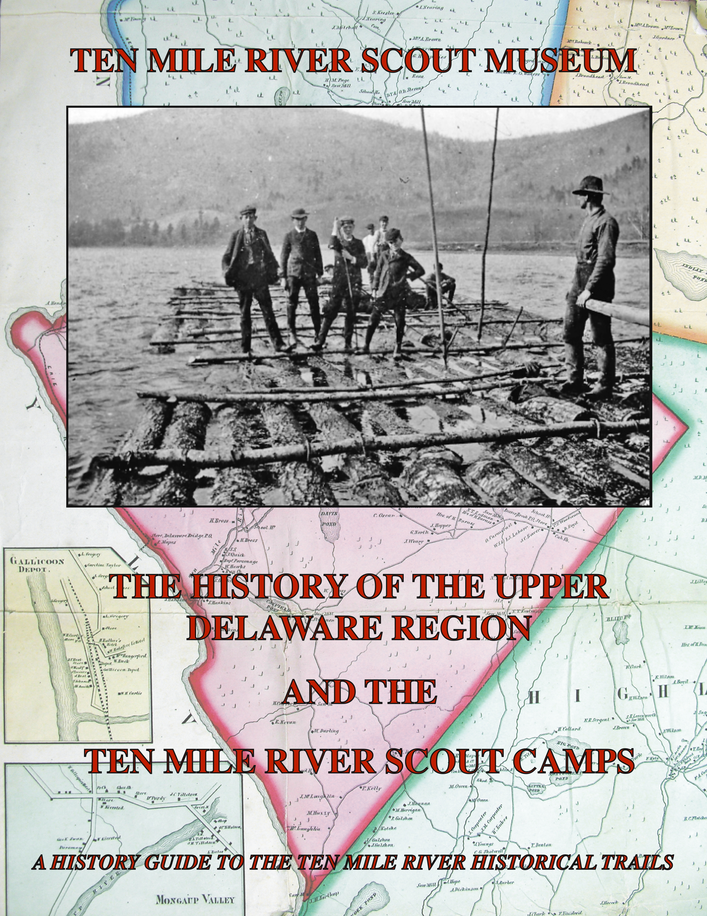
The History of the Upper Delaware Region
and the Ten Mile River Scout Camps
Illustrated history of TMR and the Upper Delaware Region.
History of all known historic sites on TMR property.
Download from www.tmrmuseum.org/tmr-trail-map website.

Slide 40
B.S.A. Historic Trails Award
To earn the award, members of your unit must plan and participate in a historic activity. A unit historic activity requires members to:
Locate a historic trail or site and study information relating to it. (The information may be obtained from an adult historic society, public library, or people living near the trail or site.)
Hike or camp two days and one night along the trail or in the vicinity of the site.
Cooperate with an adult group such as a historic society to restore and mark all or part of this trail or site. (This may be done during the hike or overnight camp.) Or cooperate with such a group to plan and stage a historic pageant, ceremony, or other public event related to this trail or site – such event should be large enough to merit coverage by the local press.
Your unit leader must then file the Historic Trails Award application with your council service center.
Download application form from www.tmrmuseum.org/tmr-trail-map website.

Slide 41
B.S.A. 50-Miler Award
The 50-Miler Award is presented to each qualifying individual for satisfactory participation in an approved trip. In order to qualify for the award the group of which the individual is a member must fulfill all of the following requirements.
Make complete and satisfactory plans for the trip, including the possibilities of advancement.
Cover the trail or canoe or boat route of not less than 50 consecutive miles; take a minimum of five consecutive days to complete the trip without the aid of motors. (In some areas pack animals may be used.)
During the time on the trail or waterway, complete a minimum of 10 hours each of group work on projects to improve the trail, springs, campsite, portage, or area. If, after checking with recognized authorities, it is not possible to complete 10 hours each of group work on the trail, a similar project may be done in the unit’s home area. (There should be no unauthorized cutting of brush or timber.)
Unit or tour leader must then file a 50-Miler Award application with the local council service center. This application gives additional details about planning the trip.
Download application form from www.tmrmuseum.org/tmr-trail-map website.

Slide 42
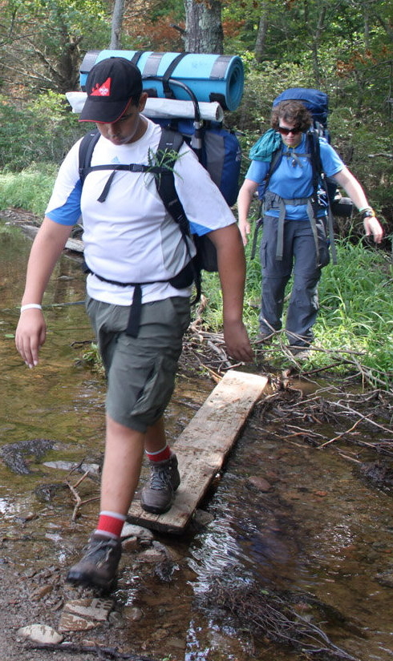
Ten things to have on every hike
(American Hiking Society)
1. Appropriate footwear. For a short day hike that doesn’t involve a heavy pack or technical terrain, trail shoes are great. For longer hikes, carrying heavier loads, or more technical terrain, hiking boots offer more support.
2. Map and compass/GPS. A map and compass not only tell you where you are and how far you have to go, it can help you find campsites, water, and an emergency exit route in case of an accident. While GPS units are very useful, always carry a map and compass as a backup.
3. Extra water and a way to purify it. Without enough water, your body's muscles and organs simply can't perform as well. Consuming too little water will not only make you thirsty, but susceptible to hypothermia and altitude sickness.

Slide 43
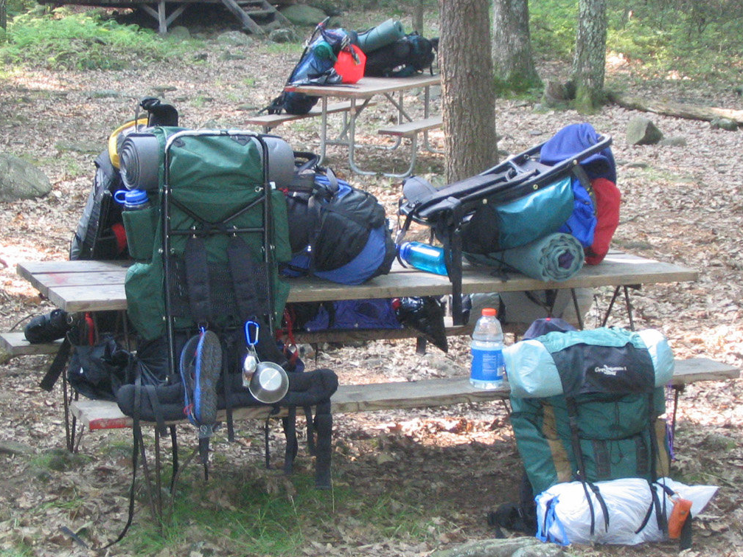
4. Extra food. Many things could keep you out longer than expected: getting lost, an injury, or difficult terrain. Extra food will help keep up energy and morale.
5. Rain gear and extra clothing. Because the weatherman is not always right. Dressing in layers allows you to adjust to changing weather and activity levels. Two rules: avoid cotton (it keeps moisture close to your skin) and always carry a hat.
6. Safety items: fire, light, and a whistle. The warmth of a fire and a hot drink can help prevent hypothermia. Fires are also a great way to signal for help if you get lost. If lost, you’ll also want the whistle as it is more effective than using your voice to call for help (use 3 short bursts)

Slide 44
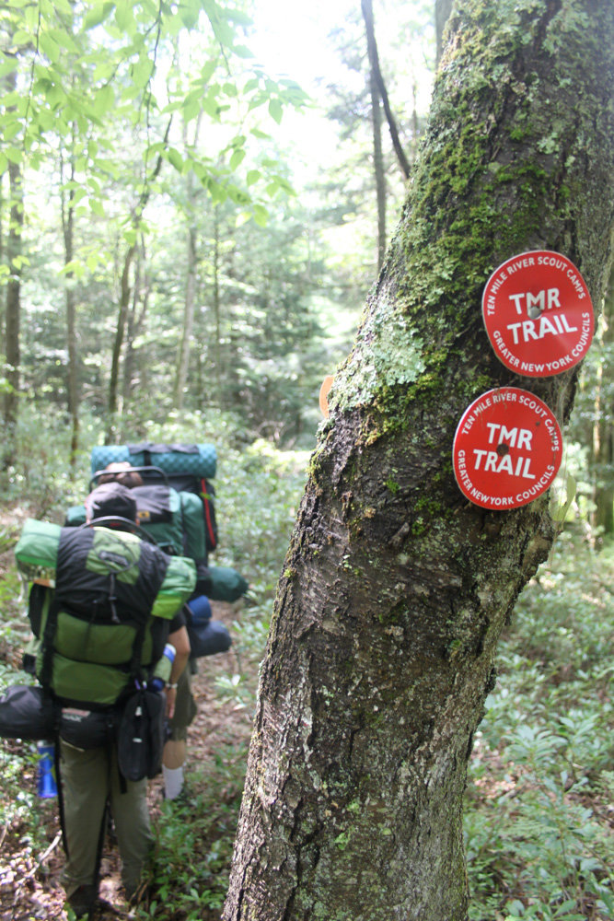
7. First aid kit. Prepackaged first aid kits for hikers are available at any outfitter. Double your effectiveness with knowledge: take a first aid class with the American Red Cross or a Wilderness First Aid class.
8. Knife or multi-purpose tool. These enable you to cut strips of cloth into bandages, remove splinters, fix broken eyeglasses, and perform a whole host of repairs on malfunctioning gear.
9. Sun screen and sun glasses. Especially above treeline when there is a skin-scorching combination of sun and snow, you'll need sunglasses to prevent snow blindness and sunscreen to prevent sunburn.
10. Daypack/backpack. You’ll want something you can carry comfortably and has the features designed to keep you hiking smartly. Don’t forget the rain cover; some packs come with one built-in. Keep the other Essentials in the pack and you’ll always be ready to hit the trail safely.

Slide 45
Any Questions?

